Slide 2

Bird Shaman
Cape Dorset
Bird Shaman
Toonoo Sharky
gk }nr

Slide 3
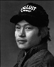
Bird Shaman
Toonoo Sharky, b. 1970
gk }nr
1995, Stone Cape Dorset, Cape Dorset Gift of Dr. Harry Winrob, 2006-516

Slide 4
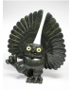

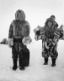
Bird Shaman
Exhibition
Toonoo Sharky, b. 1970
Community
gk }nr
REMOVED
1995, Stone Cape Dorset, Cape Dorset Gift of Dr. Harry Winrob, 2006-516

Slide 5
Bird Shaman
Exhibition
Toonoo Sharky, b. 1970
gk }nr
1995, Stone Cape Dorset, Cape Dorset Gift of Dr. Harry Winrob, 2006-516

Slide 6


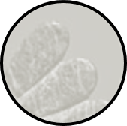
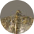
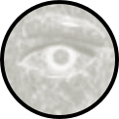
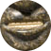
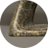
Bird Shaman
Toonoo Sharky, b. 1970
gk }nr
1995, Stone Cape Dorset, Cape Dorset Gift of Dr. Harry Winrob, 2006-516

Slide 7
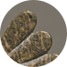
Bird Shaman
Toonoo Sharky, b. 1970
gk }nr
Shamanism among Eskimo peoples refers to those aspects of the Eskimo cultures that are related to the shamans’ role as a mediator between people and spirits, souls, and mythological beings. Such beliefs and practices were once widespread among Eskimo groups, but today are rarely practised.
1995, Stone Cape Dorset, Cape Dorset Gift of Dr. Harry Winrob, 2006-516

Slide 8
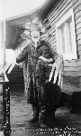
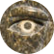
Bird Shaman
Toonoo Sharky, b. 1970
gk }nr
Shamanism among Eskimo peoples refers to those aspects of the Eskimo cultures that are related to the shamans’ role as a mediator between people and spirits, souls, and mythological beings. Such beliefs and practices were once widespread among Eskimo groups, but today are rarely practised.
1995, Stone Cape Dorset, Cape Dorset Gift of Dr. Harry Winrob, 2006-516

Slide 9
Bird Shaman
Toonoo Sharky, b. 1970
gk }nr
Shamanism among Eskimo peoples refers to those aspects of the Eskimo cultures that are related to the shamans’ role as a mediator between people and spirits, souls, and mythological beings. Such beliefs and practices were once widespread among Eskimo groups, but today are rarely practised.
Shamanism among Eskimo peoples refers to those aspects of the Eskimo cultures that are related to the shamans’ role as a mediator between people and spirits, souls, and mythological beings. Such beliefs and practices were once widespread among Eskimo groups, but today are rarely practised.
1995, Stone Cape Dorset, Cape Dorset Gift of Dr. Harry Winrob, 2006-516

Slide 10


Bird Shaman
Toonoo Sharky, b. 1970
gk }nr
Shamanism among Eskimo peoples refers to those aspects of the Eskimo cultures that are related to the shamans’ role as a mediator between people and spirits, souls, and mythological beings. Such beliefs and practices were once widespread among Eskimo groups, but today are rarely practiced.
Shamanism among Eskimo peoples refers to those aspects of the Eskimo cultures that are related to the shamans’ role as a mediator between people and spirits, souls, and mythological beings. Such beliefs and practices were once widespread among Eskimo groups, but today are rarely practiced.
1995, Stone Cape Dorset, Cape Dorset Gift of Dr. Harry Winrob, 2006-516

Slide 11
Bird Shaman
Toonoo Sharky, b. 1970
gk }nr
1995, Stone Cape Dorset, Cape Dorset Gift of Dr. Harry Winrob, 2006-516

Slide 12
Bird Shaman
Exhibition
Toonoo Sharky, b. 1970
gk }nr
1995, Stone Cape Dorset, Cape Dorset Gift of Dr. Harry Winrob, 2006-516

Slide 13
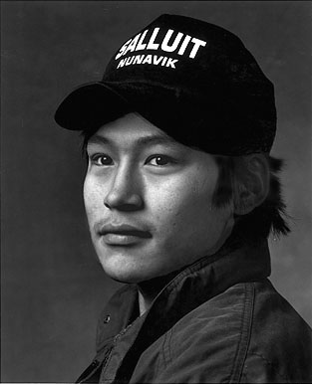

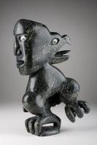
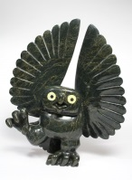
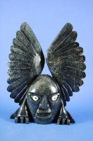
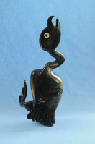
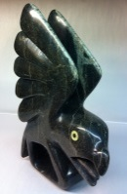
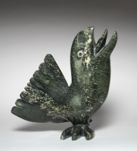
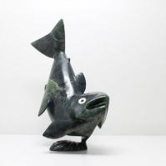
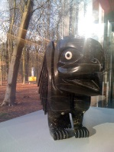
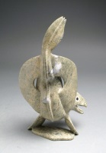
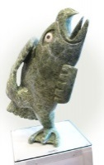
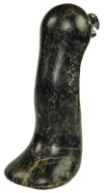
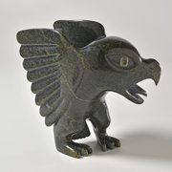
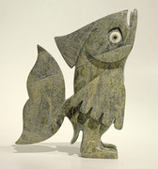
Toonoo Sharky, 1970
Cape Dorset, CA
Bird Shaman
Toonoo Sharky began carving at age nine, taught by his grandfather. His favourite subjects are “birds, and anything with wings.” But asked if he observed birds in nature, he replies: “Not often. You can look at them or work from your imagination. I don’t observe them; it is all from my head.” Toonoo’s visual statement is more emblematic than truly representative of the transformation process. For younger generations of Inuit, the imagining of shamanism and its various attributes has to a large extent supplanted actual knowledge of and belief in it.
Toonoo Sharky, b. 1970
gk }nr
1995, Stone Cape Dorset, Cape Dorset Gift of Dr. Harry Winrob, 2006-516

Slide 14
Toonoo Sharky, 1970
Cape Dorset, CA
Bird Shaman
Toonoo Sharky began carving at age nine, taught by his grandfather. His favourite subjects are “birds, and anything with wings.” But asked if he observed birds in nature, he replies: “Not often. You can look at them or work from your imagination. I don’t observe them; it is all from my head.” Toonoo’s visual statement is more emblematic than truly representative of the transformation process. For younger generations of Inuit, the imagining of shamanism and its various attributes has to a large extent supplanted actual knowledge of and belief in it.
Toonoo Sharky, b. 1970
gk }nr
1995, Stone Cape Dorset, Cape Dorset Gift of Dr. Harry Winrob, 2006-516

Slide 15
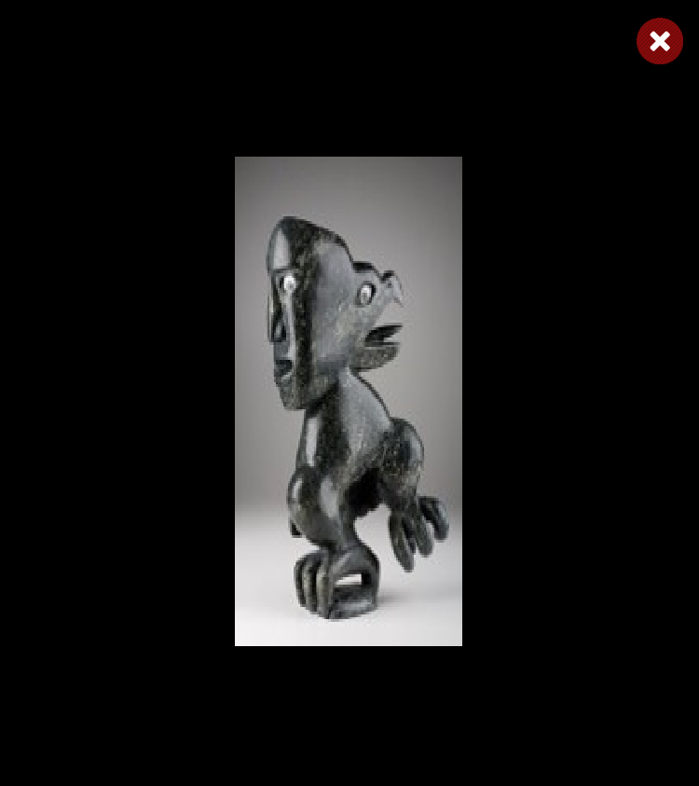
Toonoo Sharky, 1970
Cape Dorset, CA
Bird Shaman
Toonoo Sharky began carving at age nine, taught by his grandfather. His favourite subjects are “birds, and anything with wings.” But asked if he observed birds in nature, he replies: “Not often. You can look at them or work from your imagination. I don’t observe them; it is all from my head.” Toonoo’s visual statement is more emblematic than truly representative of the transformation process. For younger generations of Inuit, the imagining of shamanism and its various attributes has to a large extent supplanted actual knowledge of and belief in it.
Toonoo Sharky, b. 1970
gk }nr
1995, Stone Cape Dorset, Cape Dorset Gift of Dr. Harry Winrob, 2006-516

Slide 16
Toonoo Sharky, 1970
Cape Dorset, CA
Bird Shaman
Toonoo Sharky began carving at age nine, taught by his grandfather. His favourite subjects are “birds, and anything with wings.” But asked if he observed birds in nature, he replies: “Not often. You can look at them or work from your imagination. I don’t observe them; it is all from my head.” Toonoo’s visual statement is more emblematic than truly representative of the transformation process. For younger generations of Inuit, the imagining of shamanism and its various attributes has to a large extent supplanted actual knowledge of and belief in it.
Toonoo Sharky, b. 1970
gk }nr
1995, Stone Cape Dorset, Cape Dorset Gift of Dr. Harry Winrob, 2006-516

Slide 17
Toonoo Sharky, 1970
Cape Dorset, CA
Bird Shaman
Toonoo Sharky began carving at age nine, taught by his grandfather. His favourite subjects are “birds, and anything with wings.” But asked if he observed birds in nature, he replies: “Not often. You can look at them or work from your imagination. I don’t observe them; it is all from my head.” Toonoo’s visual statement is more emblematic than truly representative of the transformation process. For younger generations of Inuit, the imagining of shamanism and its various attributes has to a large extent supplanted actual knowledge of and belief in it.
Toonoo Sharky, b. 1970
gk }nr
1995, Stone Cape Dorset, Cape Dorset Gift of Dr. Harry Winrob, 2006-516

Slide 18
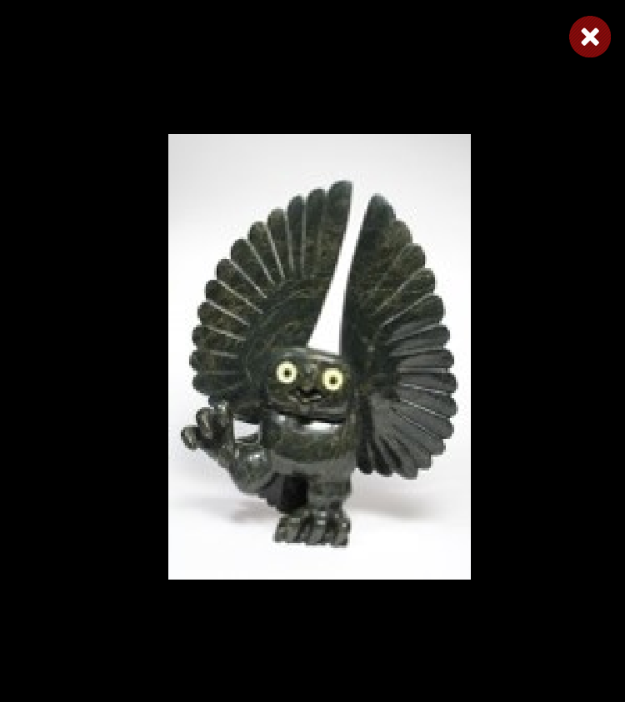
Toonoo Sharky, 1970
Cape Dorset, CA
Bird Shaman
Toonoo Sharky began carving at age nine, taught by his grandfather. His favourite subjects are “birds, and anything with wings.” But asked if he observed birds in nature, he replies: “Not often. You can look at them or work from your imagination. I don’t observe them; it is all from my head.” Toonoo’s visual statement is more emblematic than truly representative of the transformation process. For younger generations of Inuit, the imagining of shamanism and its various attributes has to a large extent supplanted actual knowledge of and belief in it.
Toonoo Sharky, b. 1970
gk }nr
1995, Stone Cape Dorset, Cape Dorset Gift of Dr. Harry Winrob, 2006-516

Slide 19
Toonoo Sharky, 1970
Cape Dorset, CA
Bird Shaman
Toonoo Sharky began carving at age nine, taught by his grandfather. His favourite subjects are “birds, and anything with wings.” But asked if he observed birds in nature, he replies: “Not often. You can look at them or work from your imagination. I don’t observe them; it is all from my head.” Toonoo’s visual statement is more emblematic than truly representative of the transformation process. For younger generations of Inuit, the imagining of shamanism and its various attributes has to a large extent supplanted actual knowledge of and belief in it.
Toonoo Sharky, b. 1970
gk }nr
1995, Stone Cape Dorset, Cape Dorset Gift of Dr. Harry Winrob, 2006-516

Slide 20
Toonoo Sharky, 1970
Cape Dorset, CA
Bird Shaman
Toonoo Sharky began carving at age nine, taught by his grandfather. His favourite subjects are “birds, and anything with wings.” But asked if he observed birds in nature, he replies: “Not often. You can look at them or work from your imagination. I don’t observe them; it is all from my head.” Toonoo’s visual statement is more emblematic than truly representative of the transformation process. For younger generations of Inuit, the imagining of shamanism and its various attributes has to a large extent supplanted actual knowledge of and belief in it.
Toonoo Sharky, b. 1970
gk }nr
1995, Stone Cape Dorset, Cape Dorset Gift of Dr. Harry Winrob, 2006-516

Slide 21
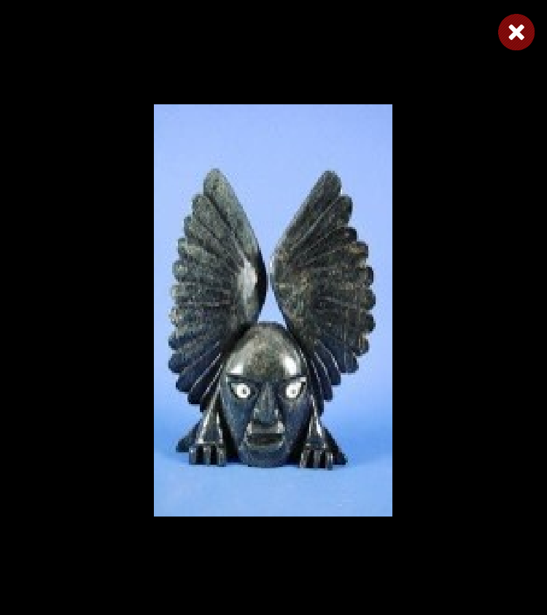
Toonoo Sharky, 1970
Cape Dorset, CA
Bird Shaman
Toonoo Sharky began carving at age nine, taught by his grandfather. His favourite subjects are “birds, and anything with wings.” But asked if he observed birds in nature, he replies: “Not often. You can look at them or work from your imagination. I don’t observe them; it is all from my head.” Toonoo’s visual statement is more emblematic than truly representative of the transformation process. For younger generations of Inuit, the imagining of shamanism and its various attributes has to a large extent supplanted actual knowledge of and belief in it.
Toonoo Sharky, b. 1970
gk }nr
1995, Stone Cape Dorset, Cape Dorset Gift of Dr. Harry Winrob, 2006-516

Slide 22
Toonoo Sharky, 1970
Cape Dorset, CA
Bird Shaman
Toonoo Sharky began carving at age nine, taught by his grandfather. His favourite subjects are “birds, and anything with wings.” But asked if he observed birds in nature, he replies: “Not often. You can look at them or work from your imagination. I don’t observe them; it is all from my head.” Toonoo’s visual statement is more emblematic than truly representative of the transformation process. For younger generations of Inuit, the imagining of shamanism and its various attributes has to a large extent supplanted actual knowledge of and belief in it.
Toonoo Sharky, b. 1970
gk }nr
1995, Stone Cape Dorset, Cape Dorset Gift of Dr. Harry Winrob, 2006-516

Slide 23
Toonoo Sharky, 1970
Cape Dorset, CA
Bird Shaman
Toonoo Sharky began carving at age nine, taught by his grandfather. His favourite subjects are “birds, and anything with wings.” But asked if he observed birds in nature, he replies: “Not often. You can look at them or work from your imagination. I don’t observe them; it is all from my head.” Toonoo’s visual statement is more emblematic than truly representative of the transformation process. For younger generations of Inuit, the imagining of shamanism and its various attributes has to a large extent supplanted actual knowledge of and belief in it.
Toonoo Sharky, b. 1970
gk }nr
1995, Stone Cape Dorset, Cape Dorset Gift of Dr. Harry Winrob, 2006-516

Slide 24
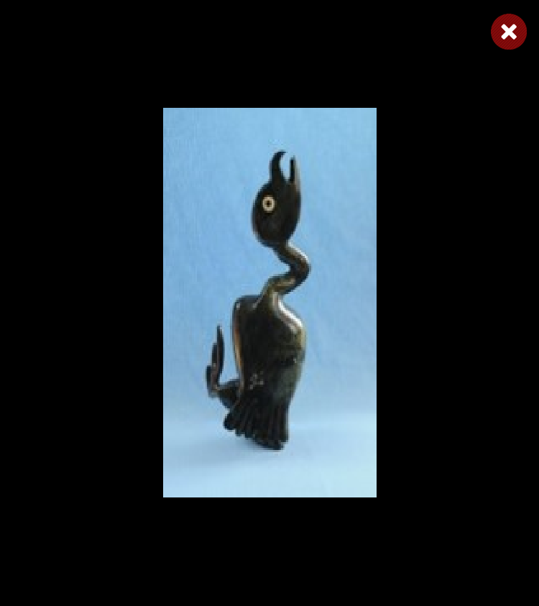
Toonoo Sharky, 1970
Cape Dorset, CA
Bird Shaman
Toonoo Sharky began carving at age nine, taught by his grandfather. His favourite subjects are “birds, and anything with wings.” But asked if he observed birds in nature, he replies: “Not often. You can look at them or work from your imagination. I don’t observe them; it is all from my head.” Toonoo’s visual statement is more emblematic than truly representative of the transformation process. For younger generations of Inuit, the imagining of shamanism and its various attributes has to a large extent supplanted actual knowledge of and belief in it.
Toonoo Sharky, b. 1970
gk }nr
1995, Stone Cape Dorset, Cape Dorset Gift of Dr. Harry Winrob, 2006-516

Slide 25
Toonoo Sharky, 1970
Cape Dorset, CA
Bird Shaman
Toonoo Sharky began carving at age nine, taught by his grandfather. His favourite subjects are “birds, and anything with wings.” But asked if he observed birds in nature, he replies: “Not often. You can look at them or work from your imagination. I don’t observe them; it is all from my head.” Toonoo’s visual statement is more emblematic than truly representative of the transformation process. For younger generations of Inuit, the imagining of shamanism and its various attributes has to a large extent supplanted actual knowledge of and belief in it.
Toonoo Sharky, b. 1970
gk }nr
1995, Stone Cape Dorset, Cape Dorset Gift of Dr. Harry Winrob, 2006-516

Slide 26
Toonoo Sharky, 1970
Cape Dorset, CA
Bird Shaman
Toonoo Sharky began carving at age nine, taught by his grandfather. His favourite subjects are “birds, and anything with wings.” But asked if he observed birds in nature, he replies: “Not often. You can look at them or work from your imagination. I don’t observe them; it is all from my head.” Toonoo’s visual statement is more emblematic than truly representative of the transformation process. For younger generations of Inuit, the imagining of shamanism and its various attributes has to a large extent supplanted actual knowledge of and belief in it.
Toonoo Sharky, b. 1970
gk }nr
1995, Stone Cape Dorset, Cape Dorset Gift of Dr. Harry Winrob, 2006-516

Slide 27

Toonoo Sharky, 1970
Cape Dorset, CA
Bird Shaman
Toonoo Sharky began carving at age nine, taught by his grandfather. His favourite subjects are “birds, and anything with wings.” But asked if he observed birds in nature, he replies: “Not often. You can look at them or work from your imagination. I don’t observe them; it is all from my head.” Toonoo’s visual statement is more emblematic than truly representative of the transformation process. For younger generations of Inuit, the imagining of shamanism and its various attributes has to a large extent supplanted actual knowledge of and belief in it.
Toonoo Sharky, b. 1970
gk }nr
1995, Stone Cape Dorset, Cape Dorset Gift of Dr. Harry Winrob, 2006-516

Slide 28
Toonoo Sharky, 1970
Cape Dorset, CA
Bird Shaman
Toonoo Sharky began carving at age nine, taught by his grandfather. His favourite subjects are “birds, and anything with wings.” But asked if he observed birds in nature, he replies: “Not often. You can look at them or work from your imagination. I don’t observe them; it is all from my head.” Toonoo’s visual statement is more emblematic than truly representative of the transformation process. For younger generations of Inuit, the imagining of shamanism and its various attributes has to a large extent supplanted actual knowledge of and belief in it.
Toonoo Sharky, b. 1970
gk }nr
1995, Stone Cape Dorset, Cape Dorset Gift of Dr. Harry Winrob, 2006-516

Slide 29
Toonoo Sharky, 1970
Cape Dorset, CA
Bird Shaman
Toonoo Sharky began carving at age nine, taught by his grandfather. His favourite subjects are “birds, and anything with wings.” But asked if he observed birds in nature, he replies: “Not often. You can look at them or work from your imagination. I don’t observe them; it is all from my head.” Toonoo’s visual statement is more emblematic than truly representative of the transformation process. For younger generations of Inuit, the imagining of shamanism and its various attributes has to a large extent supplanted actual knowledge of and belief in it.
Toonoo Sharky, b. 1970
gk }nr
1995, Stone Cape Dorset, Cape Dorset Gift of Dr. Harry Winrob, 2006-516

Slide 30
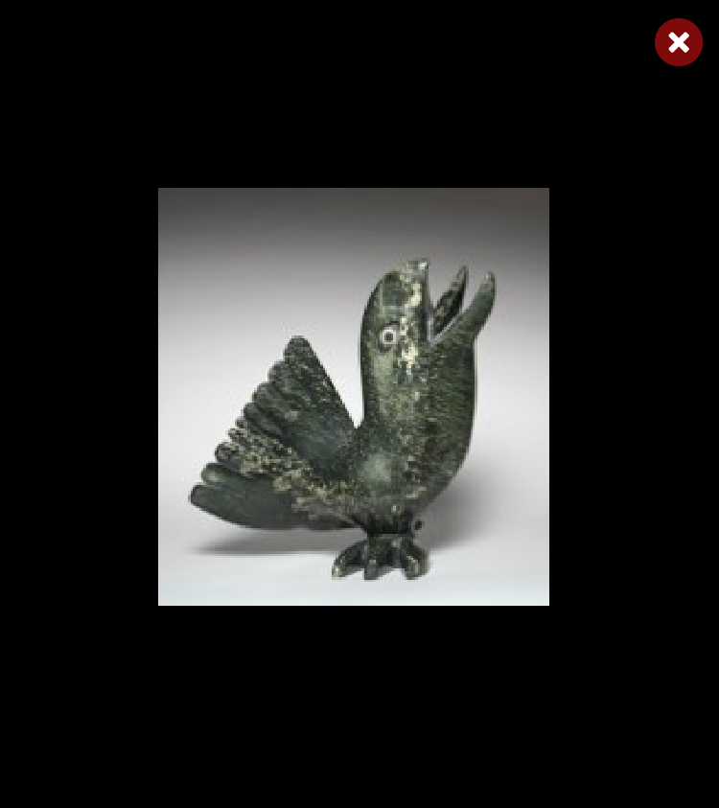
Toonoo Sharky, 1970
Cape Dorset, CA
Bird Shaman
Toonoo Sharky began carving at age nine, taught by his grandfather. His favourite subjects are “birds, and anything with wings.” But asked if he observed birds in nature, he replies: “Not often. You can look at them or work from your imagination. I don’t observe them; it is all from my head.” Toonoo’s visual statement is more emblematic than truly representative of the transformation process. For younger generations of Inuit, the imagining of shamanism and its various attributes has to a large extent supplanted actual knowledge of and belief in it.
Toonoo Sharky, b. 1970
gk }nr
1995, Stone Cape Dorset, Cape Dorset Gift of Dr. Harry Winrob, 2006-516

Slide 31
Toonoo Sharky, 1970
Cape Dorset, CA
Bird Shaman
Toonoo Sharky began carving at age nine, taught by his grandfather. His favourite subjects are “birds, and anything with wings.” But asked if he observed birds in nature, he replies: “Not often. You can look at them or work from your imagination. I don’t observe them; it is all from my head.” Toonoo’s visual statement is more emblematic than truly representative of the transformation process. For younger generations of Inuit, the imagining of shamanism and its various attributes has to a large extent supplanted actual knowledge of and belief in it.
Toonoo Sharky, b. 1970
gk }nr
1995, Stone Cape Dorset, Cape Dorset Gift of Dr. Harry Winrob, 2006-516

Slide 32
Toonoo Sharky, 1970
Cape Dorset, CA
Bird Shaman
Toonoo Sharky began carving at age nine, taught by his grandfather. His favourite subjects are “birds, and anything with wings.” But asked if he observed birds in nature, he replies: “Not often. You can look at them or work from your imagination. I don’t observe them; it is all from my head.” Toonoo’s visual statement is more emblematic than truly representative of the transformation process. For younger generations of Inuit, the imagining of shamanism and its various attributes has to a large extent supplanted actual knowledge of and belief in it.
Toonoo Sharky, b. 1970
gk }nr
1995, Stone Cape Dorset, Cape Dorset Gift of Dr. Harry Winrob, 2006-516

Slide 33
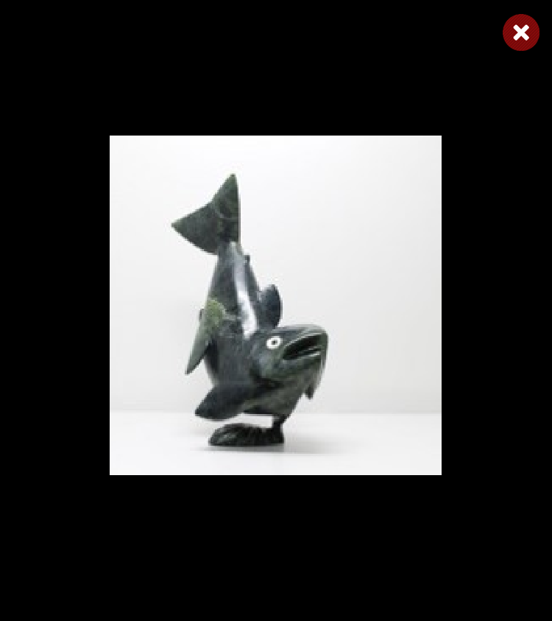
Toonoo Sharky, 1970
Cape Dorset, CA
Bird Shaman
Toonoo Sharky began carving at age nine, taught by his grandfather. His favourite subjects are “birds, and anything with wings.” But asked if he observed birds in nature, he replies: “Not often. You can look at them or work from your imagination. I don’t observe them; it is all from my head.” Toonoo’s visual statement is more emblematic than truly representative of the transformation process. For younger generations of Inuit, the imagining of shamanism and its various attributes has to a large extent supplanted actual knowledge of and belief in it.
Toonoo Sharky, b. 1970
gk }nr
1995, Stone Cape Dorset, Cape Dorset Gift of Dr. Harry Winrob, 2006-516

Slide 34
Toonoo Sharky, 1970
Cape Dorset, CA
Bird Shaman
Toonoo Sharky began carving at age nine, taught by his grandfather. His favourite subjects are “birds, and anything with wings.” But asked if he observed birds in nature, he replies: “Not often. You can look at them or work from your imagination. I don’t observe them; it is all from my head.” Toonoo’s visual statement is more emblematic than truly representative of the transformation process. For younger generations of Inuit, the imagining of shamanism and its various attributes has to a large extent supplanted actual knowledge of and belief in it.
Toonoo Sharky, b. 1970
gk }nr
1995, Stone Cape Dorset, Cape Dorset Gift of Dr. Harry Winrob, 2006-516

Slide 35
Toonoo Sharky, 1970
Cape Dorset, CA
Bird Shaman
Toonoo Sharky began carving at age nine, taught by his grandfather. His favourite subjects are “birds, and anything with wings.” But asked if he observed birds in nature, he replies: “Not often. You can look at them or work from your imagination. I don’t observe them; it is all from my head.” Toonoo’s visual statement is more emblematic than truly representative of the transformation process. For younger generations of Inuit, the imagining of shamanism and its various attributes has to a large extent supplanted actual knowledge of and belief in it.
Toonoo Sharky, b. 1970
gk }nr
1995, Stone Cape Dorset, Cape Dorset Gift of Dr. Harry Winrob, 2006-516

Slide 36
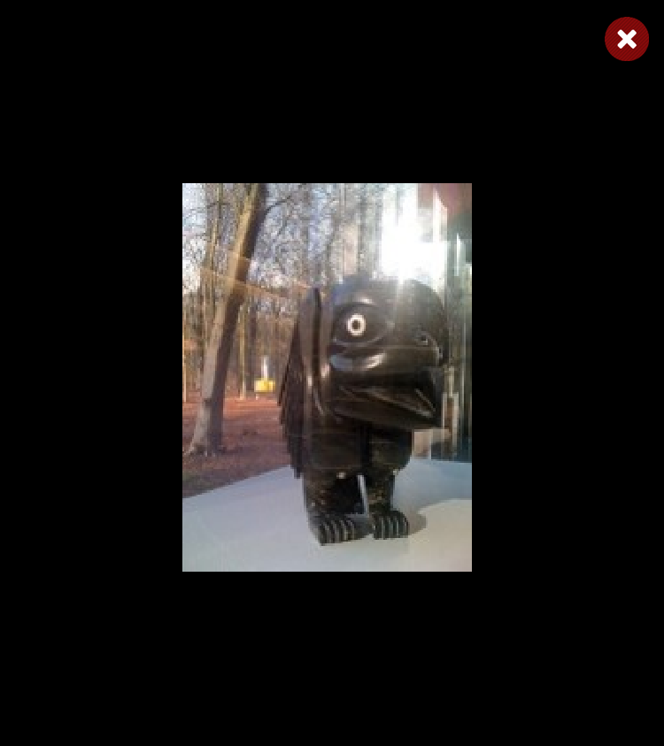
Toonoo Sharky, 1970
Cape Dorset, CA
Bird Shaman
Toonoo Sharky began carving at age nine, taught by his grandfather. His favourite subjects are “birds, and anything with wings.” But asked if he observed birds in nature, he replies: “Not often. You can look at them or work from your imagination. I don’t observe them; it is all from my head.” Toonoo’s visual statement is more emblematic than truly representative of the transformation process. For younger generations of Inuit, the imagining of shamanism and its various attributes has to a large extent supplanted actual knowledge of and belief in it.
Toonoo Sharky, b. 1970
gk }nr
1995, Stone Cape Dorset, Cape Dorset Gift of Dr. Harry Winrob, 2006-516

Slide 37
Toonoo Sharky, 1970
Cape Dorset, CA
Bird Shaman
Toonoo Sharky began carving at age nine, taught by his grandfather. His favourite subjects are “birds, and anything with wings.” But asked if he observed birds in nature, he replies: “Not often. You can look at them or work from your imagination. I don’t observe them; it is all from my head.” Toonoo’s visual statement is more emblematic than truly representative of the transformation process. For younger generations of Inuit, the imagining of shamanism and its various attributes has to a large extent supplanted actual knowledge of and belief in it.
Toonoo Sharky, b. 1970
gk }nr
1995, Stone Cape Dorset, Cape Dorset Gift of Dr. Harry Winrob, 2006-516

Slide 38
Toonoo Sharky, 1970
Cape Dorset, CA
Bird Shaman
Toonoo Sharky began carving at age nine, taught by his grandfather. His favourite subjects are “birds, and anything with wings.” But asked if he observed birds in nature, he replies: “Not often. You can look at them or work from your imagination. I don’t observe them; it is all from my head.” Toonoo’s visual statement is more emblematic than truly representative of the transformation process. For younger generations of Inuit, the imagining of shamanism and its various attributes has to a large extent supplanted actual knowledge of and belief in it.
Toonoo Sharky, b. 1970
gk }nr
1995, Stone Cape Dorset, Cape Dorset Gift of Dr. Harry Winrob, 2006-516

Slide 39
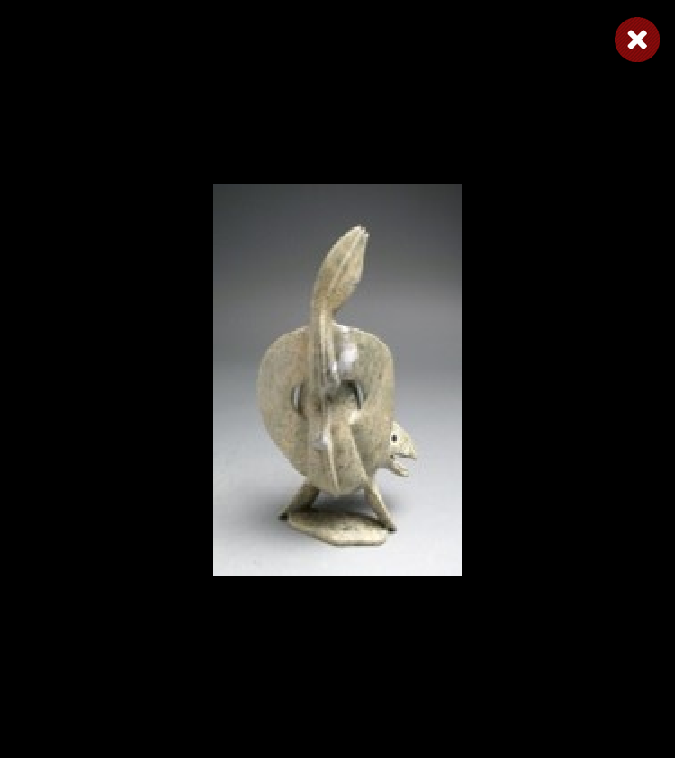
Toonoo Sharky, 1970
Cape Dorset, CA
Bird Shaman
Toonoo Sharky began carving at age nine, taught by his grandfather. His favourite subjects are “birds, and anything with wings.” But asked if he observed birds in nature, he replies: “Not often. You can look at them or work from your imagination. I don’t observe them; it is all from my head.” Toonoo’s visual statement is more emblematic than truly representative of the transformation process. For younger generations of Inuit, the imagining of shamanism and its various attributes has to a large extent supplanted actual knowledge of and belief in it.
Toonoo Sharky, b. 1970
gk }nr
1995, Stone Cape Dorset, Cape Dorset Gift of Dr. Harry Winrob, 2006-516

Slide 40
Toonoo Sharky, 1970
Cape Dorset, CA
Bird Shaman
Toonoo Sharky began carving at age nine, taught by his grandfather. His favourite subjects are “birds, and anything with wings.” But asked if he observed birds in nature, he replies: “Not often. You can look at them or work from your imagination. I don’t observe them; it is all from my head.” Toonoo’s visual statement is more emblematic than truly representative of the transformation process. For younger generations of Inuit, the imagining of shamanism and its various attributes has to a large extent supplanted actual knowledge of and belief in it.
Toonoo Sharky, b. 1970
gk }nr
1995, Stone Cape Dorset, Cape Dorset Gift of Dr. Harry Winrob, 2006-516

Slide 41
Toonoo Sharky, 1970
Cape Dorset, CA
Bird Shaman
Toonoo Sharky began carving at age nine, taught by his grandfather. His favourite subjects are “birds, and anything with wings.” But asked if he observed birds in nature, he replies: “Not often. You can look at them or work from your imagination. I don’t observe them; it is all from my head.” Toonoo’s visual statement is more emblematic than truly representative of the transformation process. For younger generations of Inuit, the imagining of shamanism and its various attributes has to a large extent supplanted actual knowledge of and belief in it.
Toonoo Sharky, b. 1970
gk }nr
1995, Stone Cape Dorset, Cape Dorset Gift of Dr. Harry Winrob, 2006-516

Slide 42
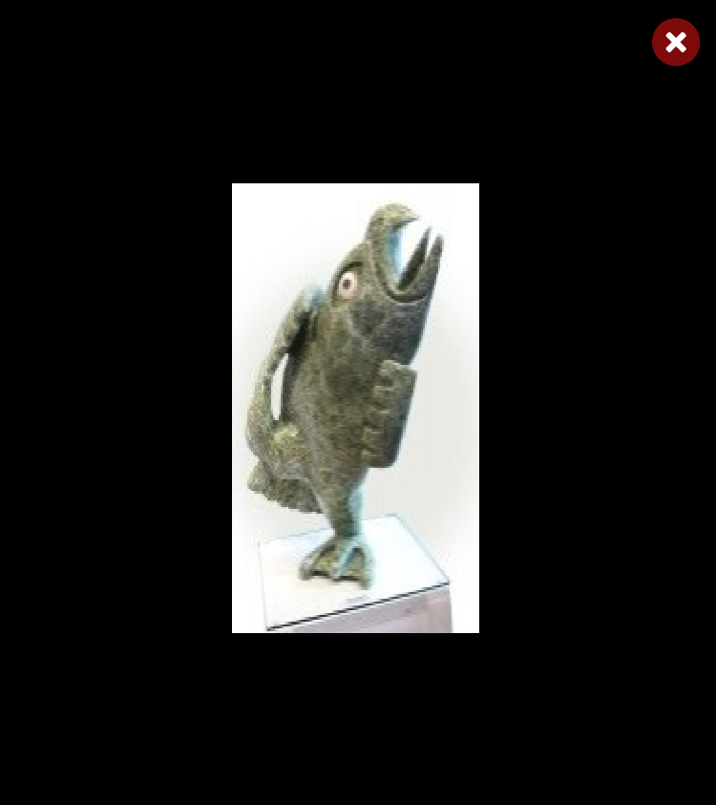
Toonoo Sharky, 1970
Cape Dorset, CA
Bird Shaman
Toonoo Sharky began carving at age nine, taught by his grandfather. His favourite subjects are “birds, and anything with wings.” But asked if he observed birds in nature, he replies: “Not often. You can look at them or work from your imagination. I don’t observe them; it is all from my head.” Toonoo’s visual statement is more emblematic than truly representative of the transformation process. For younger generations of Inuit, the imagining of shamanism and its various attributes has to a large extent supplanted actual knowledge of and belief in it.
Toonoo Sharky, b. 1970
gk }nr
1995, Stone Cape Dorset, Cape Dorset Gift of Dr. Harry Winrob, 2006-516

Slide 43
Toonoo Sharky, 1970
Cape Dorset, CA
Bird Shaman
Toonoo Sharky began carving at age nine, taught by his grandfather. His favourite subjects are “birds, and anything with wings.” But asked if he observed birds in nature, he replies: “Not often. You can look at them or work from your imagination. I don’t observe them; it is all from my head.” Toonoo’s visual statement is more emblematic than truly representative of the transformation process. For younger generations of Inuit, the imagining of shamanism and its various attributes has to a large extent supplanted actual knowledge of and belief in it.
Toonoo Sharky, b. 1970
gk }nr
1995, Stone Cape Dorset, Cape Dorset Gift of Dr. Harry Winrob, 2006-516

Slide 44
Toonoo Sharky, 1970
Cape Dorset, CA
Bird Shaman
Toonoo Sharky began carving at age nine, taught by his grandfather. His favourite subjects are “birds, and anything with wings.” But asked if he observed birds in nature, he replies: “Not often. You can look at them or work from your imagination. I don’t observe them; it is all from my head.” Toonoo’s visual statement is more emblematic than truly representative of the transformation process. For younger generations of Inuit, the imagining of shamanism and its various attributes has to a large extent supplanted actual knowledge of and belief in it.
Toonoo Sharky, b. 1970
gk }nr
1995, Stone Cape Dorset, Cape Dorset Gift of Dr. Harry Winrob, 2006-516

Slide 45
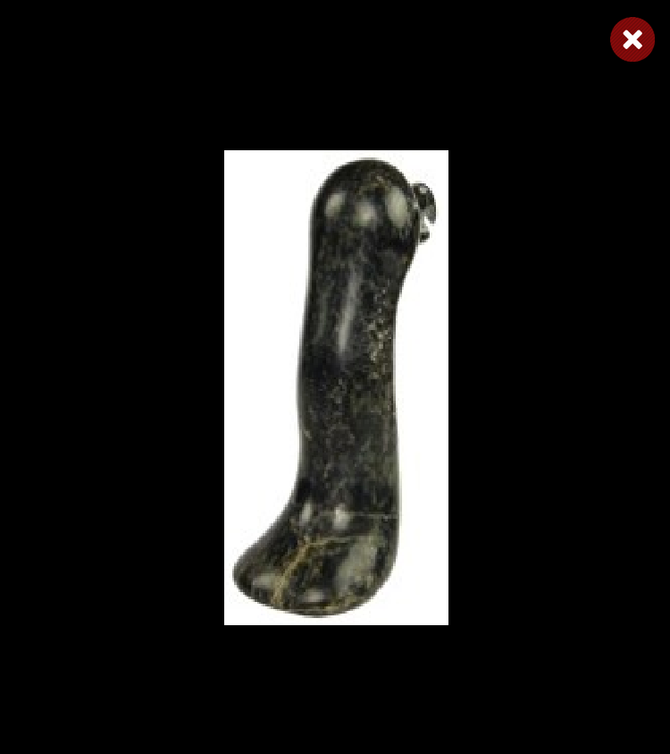
Toonoo Sharky, 1970
Cape Dorset, CA
Bird Shaman
Toonoo Sharky began carving at age nine, taught by his grandfather. His favourite subjects are “birds, and anything with wings.” But asked if he observed birds in nature, he replies: “Not often. You can look at them or work from your imagination. I don’t observe them; it is all from my head.” Toonoo’s visual statement is more emblematic than truly representative of the transformation process. For younger generations of Inuit, the imagining of shamanism and its various attributes has to a large extent supplanted actual knowledge of and belief in it.
Toonoo Sharky, b. 1970
gk }nr
1995, Stone Cape Dorset, Cape Dorset Gift of Dr. Harry Winrob, 2006-516

Slide 46
Toonoo Sharky, 1970
Cape Dorset, CA
Bird Shaman
Toonoo Sharky began carving at age nine, taught by his grandfather. His favourite subjects are “birds, and anything with wings.” But asked if he observed birds in nature, he replies: “Not often. You can look at them or work from your imagination. I don’t observe them; it is all from my head.” Toonoo’s visual statement is more emblematic than truly representative of the transformation process. For younger generations of Inuit, the imagining of shamanism and its various attributes has to a large extent supplanted actual knowledge of and belief in it.
Toonoo Sharky, b. 1970
gk }nr
1995, Stone Cape Dorset, Cape Dorset Gift of Dr. Harry Winrob, 2006-516

Slide 47
Toonoo Sharky, 1970
Cape Dorset, CA
Bird Shaman
Toonoo Sharky began carving at age nine, taught by his grandfather. His favourite subjects are “birds, and anything with wings.” But asked if he observed birds in nature, he replies: “Not often. You can look at them or work from your imagination. I don’t observe them; it is all from my head.” Toonoo’s visual statement is more emblematic than truly representative of the transformation process. For younger generations of Inuit, the imagining of shamanism and its various attributes has to a large extent supplanted actual knowledge of and belief in it.
Toonoo Sharky, b. 1970
gk }nr
1995, Stone Cape Dorset, Cape Dorset Gift of Dr. Harry Winrob, 2006-516

Slide 48
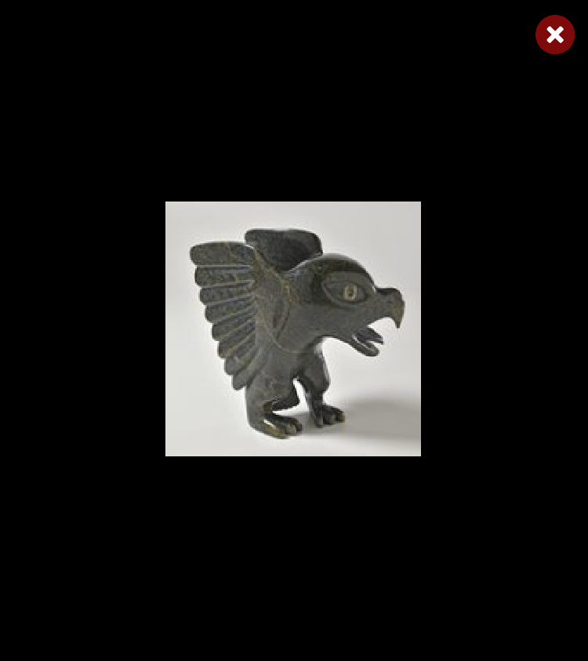
Toonoo Sharky, 1970
Cape Dorset, CA
Bird Shaman
Toonoo Sharky began carving at age nine, taught by his grandfather. His favourite subjects are “birds, and anything with wings.” But asked if he observed birds in nature, he replies: “Not often. You can look at them or work from your imagination. I don’t observe them; it is all from my head.” Toonoo’s visual statement is more emblematic than truly representative of the transformation process. For younger generations of Inuit, the imagining of shamanism and its various attributes has to a large extent supplanted actual knowledge of and belief in it.
Toonoo Sharky, b. 1970
gk }nr
1995, Stone Cape Dorset, Cape Dorset Gift of Dr. Harry Winrob, 2006-516

Slide 49
Toonoo Sharky, 1970
Cape Dorset, CA
Bird Shaman
Toonoo Sharky began carving at age nine, taught by his grandfather. His favourite subjects are “birds, and anything with wings.” But asked if he observed birds in nature, he replies: “Not often. You can look at them or work from your imagination. I don’t observe them; it is all from my head.” Toonoo’s visual statement is more emblematic than truly representative of the transformation process. For younger generations of Inuit, the imagining of shamanism and its various attributes has to a large extent supplanted actual knowledge of and belief in it.
Toonoo Sharky, b. 1970
gk }nr
1995, Stone Cape Dorset, Cape Dorset Gift of Dr. Harry Winrob, 2006-516

Slide 50
Toonoo Sharky, 1970
Cape Dorset, CA
Bird Shaman
Toonoo Sharky began carving at age nine, taught by his grandfather. His favourite subjects are “birds, and anything with wings.” But asked if he observed birds in nature, he replies: “Not often. You can look at them or work from your imagination. I don’t observe them; it is all from my head.” Toonoo’s visual statement is more emblematic than truly representative of the transformation process. For younger generations of Inuit, the imagining of shamanism and its various attributes has to a large extent supplanted actual knowledge of and belief in it.
Toonoo Sharky, b. 1970
gk }nr
1995, Stone Cape Dorset, Cape Dorset Gift of Dr. Harry Winrob, 2006-516

Slide 51
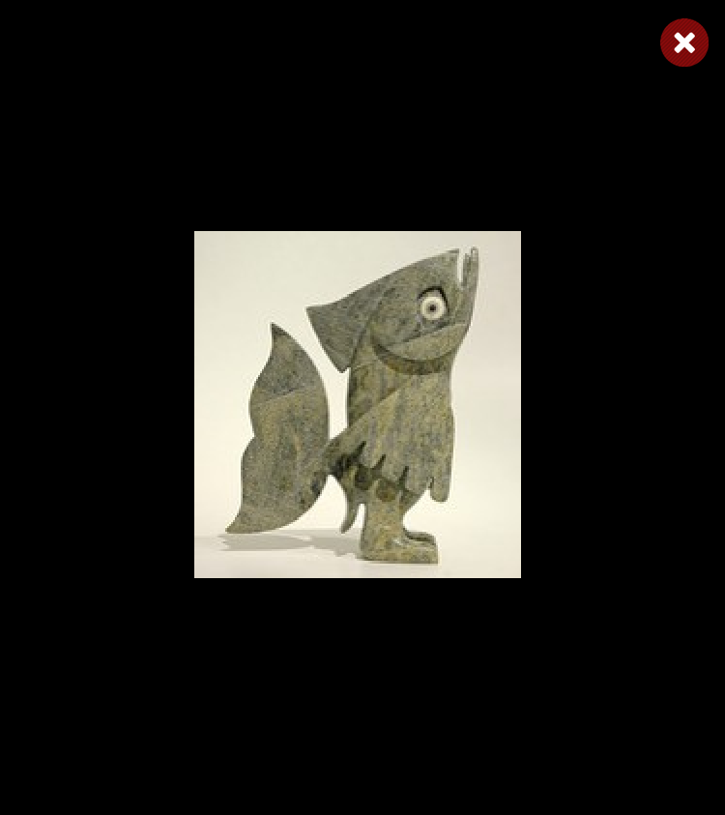
Toonoo Sharky, 1970
Cape Dorset, CA
Bird Shaman
Toonoo Sharky began carving at age nine, taught by his grandfather. His favourite subjects are “birds, and anything with wings.” But asked if he observed birds in nature, he replies: “Not often. You can look at them or work from your imagination. I don’t observe them; it is all from my head.” Toonoo’s visual statement is more emblematic than truly representative of the transformation process. For younger generations of Inuit, the imagining of shamanism and its various attributes has to a large extent supplanted actual knowledge of and belief in it.
Toonoo Sharky, b. 1970
gk }nr
1995, Stone Cape Dorset, Cape Dorset Gift of Dr. Harry Winrob, 2006-516

Slide 52
Toonoo Sharky, 1970
Cape Dorset, CA
Bird Shaman
Toonoo Sharky began carving at age nine, taught by his grandfather. His favourite subjects are “birds, and anything with wings.” But asked if he observed birds in nature, he replies: “Not often. You can look at them or work from your imagination. I don’t observe them; it is all from my head.” Toonoo’s visual statement is more emblematic than truly representative of the transformation process. For younger generations of Inuit, the imagining of shamanism and its various attributes has to a large extent supplanted actual knowledge of and belief in it.
Toonoo Sharky, b. 1970
gk }nr
1995, Stone Cape Dorset, Cape Dorset Gift of Dr. Harry Winrob, 2006-516

Slide 53
Bird Shaman
Exhibition
Toonoo Sharky, b. 1970
gk }nr
1995, Stone Cape Dorset, Cape Dorset Gift of Dr. Harry Winrob, 2006-516

Slide 54
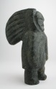
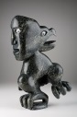

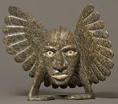
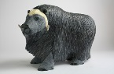
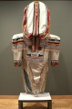

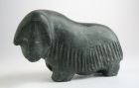
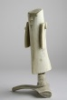
Bird Shaman
Shaman
Bird Spirits
Toonoo Sharky, b. 1970
gk }nr
Barnabus A.
Toonoo Sharky
Shaman
Steatite
Birds
Stone
Bird Shaman
Musk Ox
Toonoo Sharky
Barnabus A.
Birds
Stone
Ox
Stone
Amauti Dress
Preparing to Fly
Talerook, M.
Toonoo Sharky
Amauti
Fabric
Birds
Stone
Musk Ox
Arviat
1995, Stone Cape Dorset, Cape Dorset Gift of Dr. Harry Winrob, 2006-516
Lucassie I.
Anowtalik, L.
Ox
Antler
Antler

Slide 55
Bird Shaman
Shaman
Bird Spirits
Toonoo Sharky, b. 1970
gk }nr
Barnabus A.
Toonoo Sharky
Shaman
Steatite
Birds
Stone
Bird Shaman
Musk Ox
Toonoo Sharky
Barnabus A.
Birds
Stone
Ox
Stone
Amauti Dress
Preparing to Fly
Talerook, M.
Toonoo Sharky
Amauti
Fabric
Birds
Stone
Musk Ox
Arviat
1995, Stone Cape Dorset, Cape Dorset Gift of Dr. Harry Winrob, 2006-516
Lucassie I.
Anowtalik, L.
Ox
Antler
Antler

Slide 56
Bird Shaman
Shaman
Bird Spirits
Toonoo Sharky, b. 1970
gk }nr
Barnabus A.
Toonoo Sharky
Shaman
Steatite
Birds
Stone
Bird Shaman
Musk Ox
Toonoo Sharky
Barnabus A.
Birds
Stone
Ox
Stone
Amauti Dress
Preparing to Fly
Talerook, M.
Toonoo Sharky
Amauti
Fabric
Birds
Stone
Musk Ox
Arviat
1995, Stone Cape Dorset, Cape Dorset Gift of Dr. Harry Winrob, 2006-516
Lucassie I.
Anowtalik, L.
Ox
Antler
Antler

Slide 57
Bird Shaman
Shaman
Bird Spirits
Toonoo Sharky, b. 1970
gk }nr
Barnabus A.
Toonoo Sharky
Shaman
Steatite
Birds
Stone
Bird Shaman
Musk Ox
Toonoo Sharky
Barnabus A.
Birds
Stone
Ox
Stone
Amauti Dress
Preparing to Fly
Talerook, M.
Toonoo Sharky
Amauti
Fabric
Birds
Stone
Musk Ox
Arviat
1995, Stone Cape Dorset, Cape Dorset Gift of Dr. Harry Winrob, 2006-516
Lucassie I.
Anowtalik, L.
Ox
Antler
Antler

Slide 58
Bird Shaman
Shaman
Bird Spirits
Toonoo Sharky, b. 1970
gk }nr
Barnabus A.
Toonoo Sharky
Shaman
Steatite
Birds
Stone
Bird Shaman
Musk Ox
Toonoo Sharky
Barnabus A.
Birds
Stone
Ox
Stone
Amauti Dress
Preparing to Fly
Talerook, M.
Toonoo Sharky
Amauti
Fabric
Birds
Stone
Musk Ox
Arviat
1995, Stone Cape Dorset, Cape Dorset Gift of Dr. Harry Winrob, 2006-516
Lucassie I.
Anowtalik, L.
Ox
Antler
Antler

Slide 59
Bird Shaman
Shaman
Bird Spirits
Toonoo Sharky, b. 1970
gk }nr
Barnabus A.
Toonoo Sharky
Shaman
Steatite
Birds
Stone
Bird Shaman
Musk Ox
Toonoo Sharky
Barnabus A.
Birds
Stone
Ox
Stone
Amauti Dress
Preparing to Fly
Talerook, M.
Toonoo Sharky
Amauti
Fabric
Birds
Stone
Musk Ox
Arviat
1995, Stone Cape Dorset, Cape Dorset Gift of Dr. Harry Winrob, 2006-516
Lucassie I.
Anowtalik, L.
Ox
Antler
Antler

Slide 60
Bird Shaman
Shaman
Bird Spirits
Toonoo Sharky, b. 1970
gk }nr
Barnabus A.
Toonoo Sharky
Shaman
Steatite
Birds
Stone
Bird Shaman
Musk Ox
Toonoo Sharky
Barnabus A.
Birds
Stone
Ox
Stone
Amauti Dress
Preparing to Fly
Talerook, M.
Toonoo Sharky
Amauti
Fabric
Birds
Stone
Musk Ox
Arviat
1995, Stone Cape Dorset, Cape Dorset Gift of Dr. Harry Winrob, 2006-516
Lucassie I.
Anowtalik, L.
Ox
Antler
Antler

Slide 61
Bird Shaman
Shaman
Bird Spirits
Toonoo Sharky, b. 1970
gk }nr
Barnabus A.
Toonoo Sharky
Shaman
Steatite
Birds
Stone
Bird Shaman
Musk Ox
Toonoo Sharky
Barnabus A.
Birds
Stone
Ox
Stone
Amauti Dress
Preparing to Fly
Talerook, M.
Toonoo Sharky
Amauti
Fabric
Birds
Stone
Musk Ox
Arviat
1995, Stone Cape Dorset, Cape Dorset Gift of Dr. Harry Winrob, 2006-516
Lucassie I.
Anowtalik, L.
Ox
Antler
Antler

Slide 62
Bird Shaman
Shaman
Bird Spirits
Toonoo Sharky, b. 1970
gk }nr
Barnabus A.
Toonoo Sharky
Shaman
Steatite
Birds
Stone
Bird Shaman
Musk Ox
Toonoo Sharky
Barnabus A.
Birds
Stone
Ox
Stone
Amauti Dress
Preparing to Fly
Talerook, M.
Toonoo Sharky
Amauti
Fabric
Birds
Stone
Musk Ox
Arviat
1995, Stone Cape Dorset, Cape Dorset Gift of Dr. Harry Winrob, 2006-516
Lucassie I.
Anowtalik, L.
Ox
Antler
Antler

Slide 63
Bird Shaman
Shaman
Bird Spirits
Toonoo Sharky, b. 1970
gk }nr
Barnabus A.
Toonoo Sharky
Shaman
Steatite
Birds
Stone
Bird Shaman
Musk Ox
Toonoo Sharky
Barnabus A.
Birds
Stone
Ox
Stone
Amauti Dress
Preparing to Fly
Talerook, M.
Toonoo Sharky
Amauti
Fabric
Birds
Stone
Musk Ox
Arviat
1995, Stone Cape Dorset, Cape Dorset Gift of Dr. Harry Winrob, 2006-516
Lucassie I.
Anowtalik, L.
Ox
Antler
Antler

Slide 64
Bird Shaman
Shaman
Bird Spirits
Toonoo Sharky, b. 1970
gk }nr
Barnabus A.
Toonoo Sharky
Shaman
Steatite
Birds
Stone
Bird Shaman
Musk Ox
Toonoo Sharky
Barnabus A.
Birds
Stone
Ox
Stone
Amauti Dress
Preparing to Fly
Talerook, M.
Toonoo Sharky
Amauti
Fabric
Birds
Stone
Musk Ox
Arviat
1995, Stone Cape Dorset, Cape Dorset Gift of Dr. Harry Winrob, 2006-516
Lucassie I.
Anowtalik, L.
Ox
Antler
Antler

Slide 65
Bird Shaman
Shaman
Bird Spirits
Toonoo Sharky, b. 1970
gk }nr
Barnabus A.
Toonoo Sharky
Shaman
Steatite
Birds
Stone
Bird Shaman
Musk Ox
Toonoo Sharky
Barnabus A.
Birds
Stone
Ox
Stone
Amauti Dress
Preparing to Fly
Talerook, M.
Toonoo Sharky
Amauti
Fabric
Birds
Stone
Musk Ox
Arviat
1995, Stone Cape Dorset, Cape Dorset Gift of Dr. Harry Winrob, 2006-516
Lucassie I.
Anowtalik, L.
Ox
Antler
Antler

Slide 66
Bird Shaman
Shaman
Bird Spirits
Toonoo Sharky, b. 1970
gk }nr
Barnabus A.
Toonoo Sharky
Shaman
Steatite
Birds
Stone
Bird Shaman
Musk Ox
Toonoo Sharky
Barnabus A.
Birds
Stone
Ox
Stone
Amauti Dress
Preparing to Fly
Talerook, M.
Toonoo Sharky
Amauti
Fabric
Birds
Stone
Musk Ox
Arviat
1995, Stone Cape Dorset, Cape Dorset Gift of Dr. Harry Winrob, 2006-516
Lucassie I.
Anowtalik, L.
Ox
Antler
Antler

Slide 67
Bird Shaman
Shaman
Bird Spirits
Toonoo Sharky, b. 1970
gk }nr
Barnabus A.
Toonoo Sharky
Shaman
Steatite
Birds
Stone
Bird Shaman
Musk Ox
Toonoo Sharky
Barnabus A.
Birds
Stone
Ox
Stone
Amauti Dress
Preparing to Fly
Talerook, M.
Toonoo Sharky
Amauti
Fabric
Birds
Stone
Musk Ox
Arviat
1995, Stone Cape Dorset, Cape Dorset Gift of Dr. Harry Winrob, 2006-516
Lucassie I.
Anowtalik, L.
Ox
Antler
Antler

Slide 68
Bird Shaman
Shaman
Bird Spirits
Toonoo Sharky, b. 1970
gk }nr
Barnabus A.
Toonoo Sharky
Shaman
Steatite
Birds
Stone
Bird Shaman
Musk Ox
Toonoo Sharky
Barnabus A.
Birds
Stone
Ox
Stone
Amauti Dress
Preparing to Fly
Talerook, M.
Toonoo Sharky
Amauti
Fabric
Birds
Stone
Musk Ox
Arviat
1995, Stone Cape Dorset, Cape Dorset Gift of Dr. Harry Winrob, 2006-516
Lucassie I.
Anowtalik, L.
Ox
Antler
Antler

Slide 69
Bird Shaman
Shaman
Bird Spirits
Toonoo Sharky, b. 1970
gk }nr
Barnabus A.
Toonoo Sharky
Shaman
Steatite
Birds
Stone
Bird Shaman
Musk Ox
Toonoo Sharky
Barnabus A.
Birds
Stone
Ox
Stone
Amauti Dress
Preparing to Fly
Talerook, M.
Toonoo Sharky
Amauti
Fabric
Birds
Stone
Musk Ox
Arviat
1995, Stone Cape Dorset, Cape Dorset Gift of Dr. Harry Winrob, 2006-516
Lucassie I.
Anowtalik, L.
Ox
Antler
Antler

Slide 70
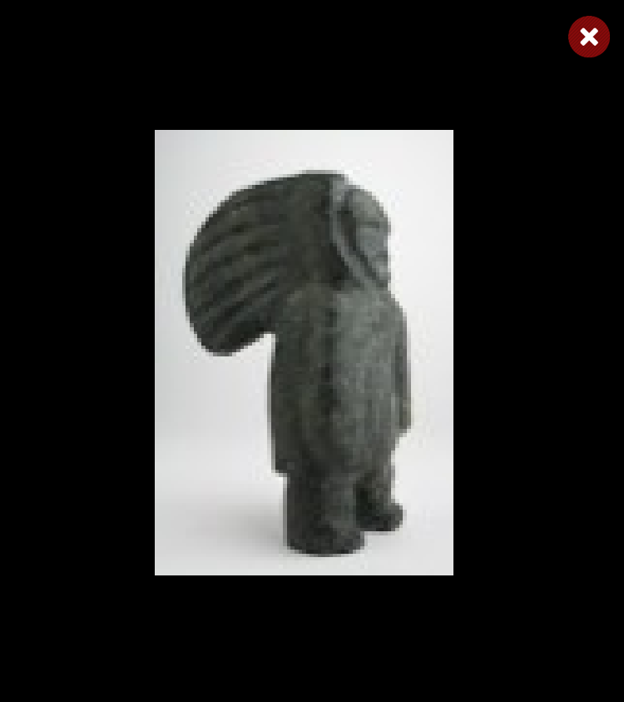
Bird Shaman
Shaman
Bird Spirits
Toonoo Sharky, b. 1970
gk }nr
Barnabus A.
Toonoo Sharky
Shaman
Steatite
Birds
Stone
Bird Shaman
Musk Ox
Toonoo Sharky
Barnabus A.
Birds
Stone
Ox
Stone
Amauti Dress
Preparing to Fly
Talerook, M.
Toonoo Sharky
Amauti
Fabric
Birds
Stone
Musk Ox
Arviat
1995, Stone Cape Dorset, Cape Dorset Gift of Dr. Harry Winrob, 2006-516
Lucassie I.
Anowtalik, L.
Ox
Antler
Antler

Slide 71
Bird Shaman
Shaman
Bird Spirits
Toonoo Sharky, b. 1970
gk }nr
Barnabus A.
Toonoo Sharky
Shaman
Steatite
Birds
Stone
Bird Shaman
Musk Ox
Toonoo Sharky
Barnabus A.
Birds
Stone
Ox
Stone
Amauti Dress
Preparing to Fly
Talerook, M.
Toonoo Sharky
Amauti
Fabric
Birds
Stone
Musk Ox
Arviat
1995, Stone Cape Dorset, Cape Dorset Gift of Dr. Harry Winrob, 2006-516
Lucassie I.
Anowtalik, L.
Ox
Antler
Antler

Slide 72
Bird Shaman
Shaman
Bird Spirits
Toonoo Sharky, b. 1970
gk }nr
Barnabus A.
Toonoo Sharky
Shaman
Steatite
Birds
Stone
Bird Shaman
Musk Ox
Toonoo Sharky
Barnabus A.
Birds
Stone
Ox
Stone
Amauti Dress
Preparing to Fly
Talerook, M.
Toonoo Sharky
Amauti
Fabric
Birds
Stone
Musk Ox
Arviat
1995, Stone Cape Dorset, Cape Dorset Gift of Dr. Harry Winrob, 2006-516
Lucassie I.
Anowtalik, L.
Ox
Antler
Antler

Slide 73
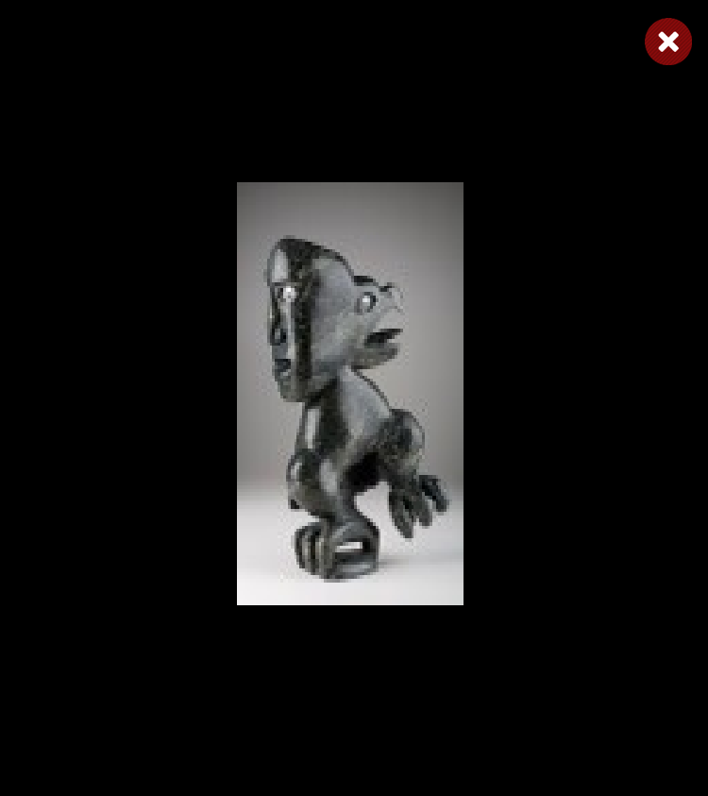
Bird Shaman
Shaman
Bird Spirits
Toonoo Sharky, b. 1970
gk }nr
Barnabus A.
Toonoo Sharky
Shaman
Steatite
Birds
Stone
Bird Shaman
Musk Ox
Toonoo Sharky
Barnabus A.
Birds
Stone
Ox
Stone
Amauti Dress
Preparing to Fly
Talerook, M.
Toonoo Sharky
Amauti
Fabric
Birds
Stone
Musk Ox
Arviat
1995, Stone Cape Dorset, Cape Dorset Gift of Dr. Harry Winrob, 2006-516
Lucassie I.
Anowtalik, L.
Ox
Antler
Antler

Slide 74
Bird Shaman
Shaman
Bird Spirits
Toonoo Sharky, b. 1970
gk }nr
Barnabus A.
Toonoo Sharky
Shaman
Steatite
Birds
Stone
Bird Shaman
Musk Ox
Toonoo Sharky
Barnabus A.
Birds
Stone
Ox
Stone
Amauti Dress
Preparing to Fly
Talerook, M.
Toonoo Sharky
Amauti
Fabric
Birds
Stone
Musk Ox
Arviat
1995, Stone Cape Dorset, Cape Dorset Gift of Dr. Harry Winrob, 2006-516
Lucassie I.
Anowtalik, L.
Ox
Antler
Antler

Slide 75
Bird Shaman
Shaman
Bird Spirits
Toonoo Sharky, b. 1970
gk }nr
Barnabus A.
Toonoo Sharky
Shaman
Steatite
Birds
Stone
Bird Shaman
Musk Ox
Toonoo Sharky
Barnabus A.
Birds
Stone
Ox
Stone
Amauti Dress
Preparing to Fly
Talerook, M.
Toonoo Sharky
Amauti
Fabric
Birds
Stone
Musk Ox
Arviat
1995, Stone Cape Dorset, Cape Dorset Gift of Dr. Harry Winrob, 2006-516
Lucassie I.
Anowtalik, L.
Ox
Antler
Antler

Slide 76
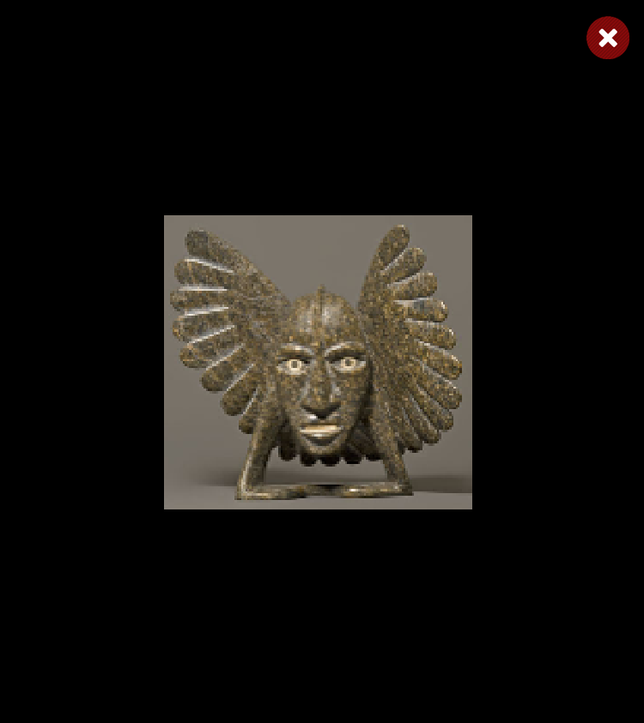
Bird Shaman
Shaman
Bird Spirits
Toonoo Sharky, b. 1970
gk }nr
Barnabus A.
Toonoo Sharky
Shaman
Steatite
Birds
Stone
Bird Shaman
Musk Ox
Toonoo Sharky
Barnabus A.
Birds
Stone
Ox
Stone
Amauti Dress
Preparing to Fly
Talerook, M.
Toonoo Sharky
Amauti
Fabric
Birds
Stone
Musk Ox
Arviat
1995, Stone Cape Dorset, Cape Dorset Gift of Dr. Harry Winrob, 2006-516
Lucassie I.
Anowtalik, L.
Ox
Antler
Antler

Slide 77
Bird Shaman
Shaman
Bird Spirits
Toonoo Sharky, b. 1970
gk }nr
Barnabus A.
Toonoo Sharky
Shaman
Steatite
Birds
Stone
Bird Shaman
Musk Ox
Toonoo Sharky
Barnabus A.
Birds
Stone
Ox
Stone
Amauti Dress
Preparing to Fly
Talerook, M.
Toonoo Sharky
Amauti
Fabric
Birds
Stone
Musk Ox
Arviat
1995, Stone Cape Dorset, Cape Dorset Gift of Dr. Harry Winrob, 2006-516
Lucassie I.
Anowtalik, L.
Ox
Antler
Antler

Slide 78
Bird Shaman
Shaman
Bird Spirits
Toonoo Sharky, b. 1970
gk }nr
Barnabus A.
Toonoo Sharky
Shaman
Steatite
Birds
Stone
Bird Shaman
Musk Ox
Toonoo Sharky
Barnabus A.
Birds
Stone
Ox
Stone
Amauti Dress
Preparing to Fly
Talerook, M.
Toonoo Sharky
Amauti
Fabric
Birds
Stone
Musk Ox
Arviat
1995, Stone Cape Dorset, Cape Dorset Gift of Dr. Harry Winrob, 2006-516
Lucassie I.
Anowtalik, L.
Ox
Antler
Antler

Slide 79
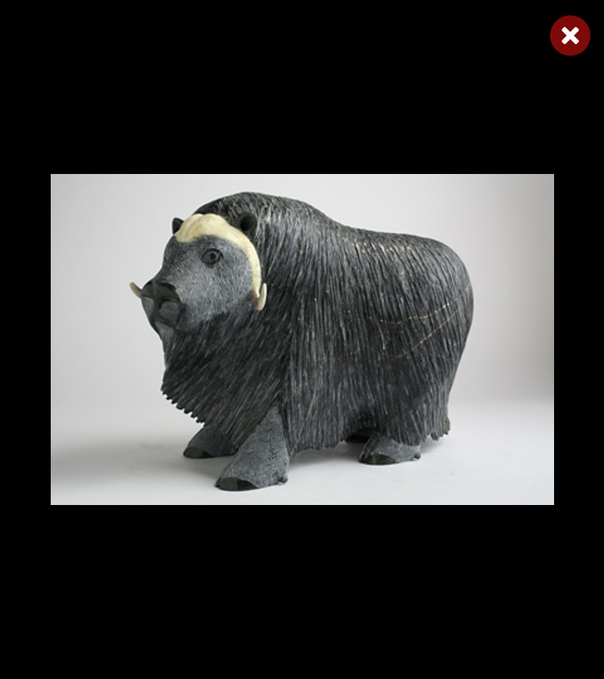
Bird Shaman
Shaman
Bird Spirits
Toonoo Sharky, b. 1970
gk }nr
Barnabus A.
Toonoo Sharky
Shaman
Steatite
Birds
Stone
Bird Shaman
Musk Ox
Toonoo Sharky
Barnabus A.
Birds
Stone
Ox
Stone
Amauti Dress
Preparing to Fly
Talerook, M.
Toonoo Sharky
Amauti
Fabric
Birds
Stone
Musk Ox
Arviat
1995, Stone Cape Dorset, Cape Dorset Gift of Dr. Harry Winrob, 2006-516
Lucassie I.
Anowtalik, L.
Ox
Antler
Antler

Slide 80
Bird Shaman
Shaman
Bird Spirits
Toonoo Sharky, b. 1970
gk }nr
Barnabus A.
Toonoo Sharky
Shaman
Steatite
Birds
Stone
Bird Shaman
Musk Ox
Toonoo Sharky
Barnabus A.
Birds
Stone
Ox
Stone
Amauti Dress
Preparing to Fly
Talerook, M.
Toonoo Sharky
Amauti
Fabric
Birds
Stone
Musk Ox
Arviat
1995, Stone Cape Dorset, Cape Dorset Gift of Dr. Harry Winrob, 2006-516
Lucassie I.
Anowtalik, L.
Ox
Antler
Antler

Slide 81
Bird Shaman
Shaman
Bird Spirits
Toonoo Sharky, b. 1970
gk }nr
Barnabus A.
Toonoo Sharky
Shaman
Steatite
Birds
Stone
Bird Shaman
Musk Ox
Toonoo Sharky
Barnabus A.
Birds
Stone
Ox
Stone
Amauti Dress
Preparing to Fly
Talerook, M.
Toonoo Sharky
Amauti
Fabric
Birds
Stone
Musk Ox
Arviat
1995, Stone Cape Dorset, Cape Dorset Gift of Dr. Harry Winrob, 2006-516
Lucassie I.
Anowtalik, L.
Ox
Antler
Antler

Slide 82
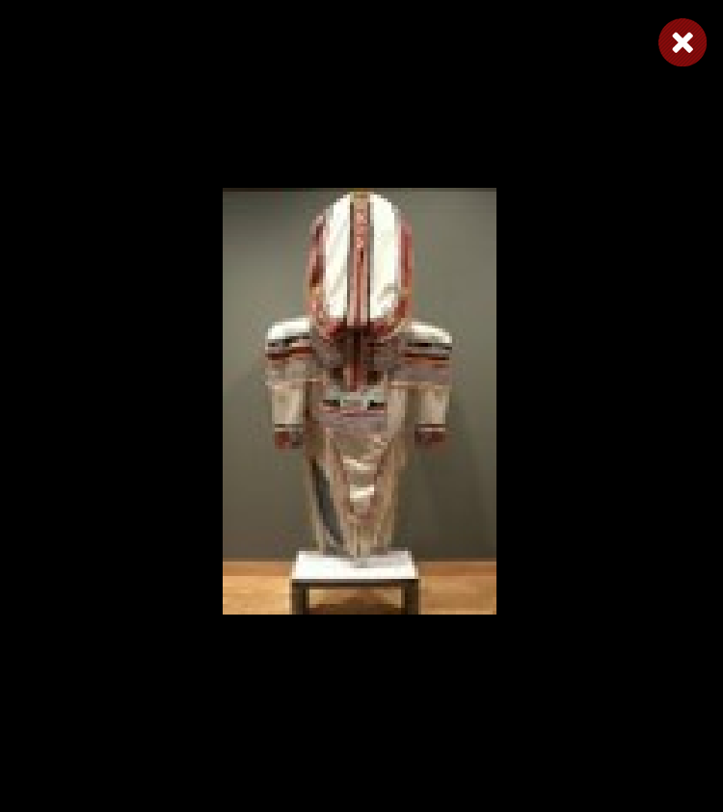
Bird Shaman
Shaman
Bird Spirits
Toonoo Sharky, b. 1970
gk }nr
Barnabus A.
Toonoo Sharky
Shaman
Steatite
Birds
Stone
Bird Shaman
Musk Ox
Toonoo Sharky
Barnabus A.
Birds
Stone
Ox
Stone
Amauti Dress
Preparing to Fly
Talerook, M.
Toonoo Sharky
Amauti
Fabric
Birds
Stone
Musk Ox
Arviat
1995, Stone Cape Dorset, Cape Dorset Gift of Dr. Harry Winrob, 2006-516
Lucassie I.
Anowtalik, L.
Ox
Antler
Antler

Slide 83
Bird Shaman
Shaman
Bird Spirits
Toonoo Sharky, b. 1970
gk }nr
Barnabus A.
Toonoo Sharky
Shaman
Steatite
Birds
Stone
Bird Shaman
Musk Ox
Toonoo Sharky
Barnabus A.
Birds
Stone
Ox
Stone
Amauti Dress
Preparing to Fly
Talerook, M.
Toonoo Sharky
Amauti
Fabric
Birds
Stone
Musk Ox
Arviat
1995, Stone Cape Dorset, Cape Dorset Gift of Dr. Harry Winrob, 2006-516
Lucassie I.
Anowtalik, L.
Ox
Antler
Antler

Slide 84
Bird Shaman
Shaman
Bird Spirits
Toonoo Sharky, b. 1970
gk }nr
Barnabus A.
Toonoo Sharky
Shaman
Steatite
Birds
Stone
Bird Shaman
Musk Ox
Toonoo Sharky
Barnabus A.
Birds
Stone
Ox
Stone
Amauti Dress
Preparing to Fly
Talerook, M.
Toonoo Sharky
Amauti
Fabric
Birds
Stone
Musk Ox
Arviat
1995, Stone Cape Dorset, Cape Dorset Gift of Dr. Harry Winrob, 2006-516
Lucassie I.
Anowtalik, L.
Ox
Antler
Antler

Slide 85
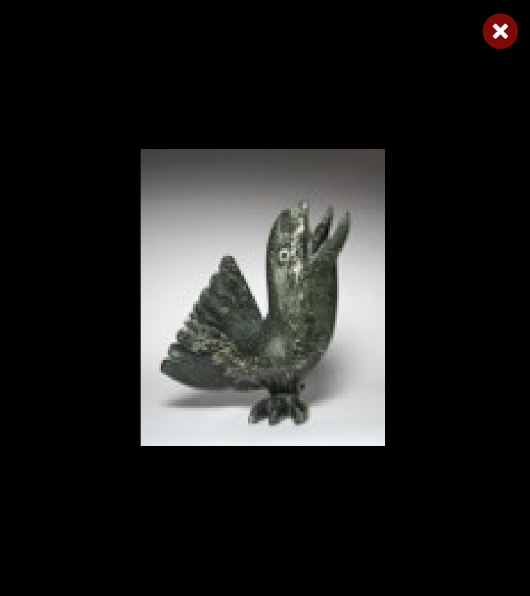
Bird Shaman
Shaman
Bird Spirits
Toonoo Sharky, b. 1970
gk }nr
Barnabus A.
Toonoo Sharky
Shaman
Steatite
Birds
Stone
Bird Shaman
Musk Ox
Toonoo Sharky
Barnabus A.
Birds
Stone
Ox
Stone
Amauti Dress
Preparing to Fly
Talerook, M.
Toonoo Sharky
Amauti
Fabric
Birds
Stone
Musk Ox
Arviat
1995, Stone Cape Dorset, Cape Dorset Gift of Dr. Harry Winrob, 2006-516
Lucassie I.
Anowtalik, L.
Ox
Antler
Antler

Slide 86
Bird Shaman
Shaman
Bird Spirits
Toonoo Sharky, b. 1970
gk }nr
Barnabus A.
Toonoo Sharky
Shaman
Steatite
Birds
Stone
Bird Shaman
Musk Ox
Toonoo Sharky
Barnabus A.
Birds
Stone
Ox
Stone
Amauti Dress
Preparing to Fly
Talerook, M.
Toonoo Sharky
Amauti
Fabric
Birds
Stone
Musk Ox
Arviat
1995, Stone Cape Dorset, Cape Dorset Gift of Dr. Harry Winrob, 2006-516
Lucassie I.
Anowtalik, L.
Ox
Antler
Antler

Slide 87
Bird Shaman
Shaman
Bird Spirits
Toonoo Sharky, b. 1970
gk }nr
Barnabus A.
Toonoo Sharky
Shaman
Steatite
Birds
Stone
Bird Shaman
Musk Ox
Toonoo Sharky
Barnabus A.
Birds
Stone
Ox
Stone
Amauti Dress
Preparing to Fly
Talerook, M.
Toonoo Sharky
Amauti
Fabric
Birds
Stone
Musk Ox
Arviat
1995, Stone Cape Dorset, Cape Dorset Gift of Dr. Harry Winrob, 2006-516
Lucassie I.
Anowtalik, L.
Ox
Antler
Antler

Slide 88

Bird Shaman
Shaman
Bird Spirits
Toonoo Sharky, b. 1970
gk }nr
Barnabus A.
Toonoo Sharky
Shaman
Steatite
Birds
Stone
Bird Shaman
Musk Ox
Toonoo Sharky
Barnabus A.
Birds
Stone
Ox
Stone
Amauti Dress
Preparing to Fly
Talerook, M.
Toonoo Sharky
Amauti
Fabric
Birds
Stone
Musk Ox
Arviat
1995, Stone Cape Dorset, Cape Dorset Gift of Dr. Harry Winrob, 2006-516
Lucassie I.
Anowtalik, L.
Ox
Antler
Antler

Slide 89
Bird Shaman
Shaman
Bird Spirits
Toonoo Sharky, b. 1970
gk }nr
Barnabus A.
Toonoo Sharky
Shaman
Steatite
Birds
Stone
Bird Shaman
Musk Ox
Toonoo Sharky
Barnabus A.
Birds
Stone
Ox
Stone
Amauti Dress
Preparing to Fly
Talerook, M.
Toonoo Sharky
Amauti
Fabric
Birds
Stone
Musk Ox
Arviat
1995, Stone Cape Dorset, Cape Dorset Gift of Dr. Harry Winrob, 2006-516
Lucassie I.
Anowtalik, L.
Ox
Antler
Antler

Slide 90
Bird Shaman
Shaman
Bird Spirits
Toonoo Sharky, b. 1970
gk }nr
Barnabus A.
Toonoo Sharky
Shaman
Steatite
Birds
Stone
Bird Shaman
Musk Ox
Toonoo Sharky
Barnabus A.
Birds
Stone
Ox
Stone
Amauti Dress
Preparing to Fly
Talerook, M.
Toonoo Sharky
Amauti
Fabric
Birds
Stone
Musk Ox
Arviat
1995, Stone Cape Dorset, Cape Dorset Gift of Dr. Harry Winrob, 2006-516
Lucassie I.
Anowtalik, L.
Ox
Antler
Antler

Slide 91

Bird Shaman
Shaman
Bird Spirits
Toonoo Sharky, b. 1970
gk }nr
Barnabus A.
Toonoo Sharky
Shaman
Steatite
Birds
Stone
Bird Shaman
Musk Ox
Toonoo Sharky
Barnabus A.
Birds
Stone
Ox
Stone
Amauti Dress
Preparing to Fly
Talerook, M.
Toonoo Sharky
Amauti
Fabric
Birds
Stone
Musk Ox
Arviat
1995, Stone Cape Dorset, Cape Dorset Gift of Dr. Harry Winrob, 2006-516
Lucassie I.
Anowtalik, L.
Ox
Antler
Antler

Slide 92
Bird Shaman
Shaman
Bird Spirits
Toonoo Sharky, b. 1970
gk }nr
Barnabus A.
Toonoo Sharky
Shaman
Steatite
Birds
Stone
Bird Shaman
Musk Ox
Toonoo Sharky
Barnabus A.
Birds
Stone
Ox
Stone
Amauti Dress
Preparing to Fly
Talerook, M.
Toonoo Sharky
Amauti
Fabric
Birds
Stone
Musk Ox
Arviat
1995, Stone Cape Dorset, Cape Dorset Gift of Dr. Harry Winrob, 2006-516
Lucassie I.
Anowtalik, L.
Ox
Antler
Antler

Slide 93

Bird Shaman
Shaman
Bird Spirits
Toonoo Sharky, b. 1970
gk }nr
Barnabus A.
Toonoo Sharky
Shaman
Steatite
Birds
Stone
Bird Shaman
Musk Ox
Toonoo Sharky
Barnabus A.
Birds
Stone
Ox
Stone
Amauti Dress
Preparing to Fly
Talerook, M.
Toonoo Sharky
Amauti
Fabric
Birds
Stone
Musk Ox
Arviat
1995, Stone Cape Dorset, Cape Dorset Gift of Dr. Harry Winrob, 2006-516
Lucassie I.
Anowtalik, L.
Ox
Antler
Antler

Slide 94
Bird Shaman
Exhibition
Toonoo Sharky, b. 1970
gk }nr
1995, Stone Cape Dorset, Cape Dorset Gift of Dr. Harry Winrob, 2006-516

Slide 95
Bird Shaman
Toonoo Sharky, b. 1970
gk }nr
1995, Stone Cape Dorset, Cape Dorset Gift of Dr. Harry Winrob, 2006-516

